Slide 1
AN INNOVATIVE SMS BASED VOTING SYSTEM
PROJECT BY
Abishek S
Arun Kumar S
Deepak P
IVth year CSE dept.
MNM JEC, Chennai-97
GUIDED BY
Mrs.A.Geethapriya
M.E.,(Ph.D).,
Assistant Professor

Slide 2
OBJECTIVES
To enable automated message monitoring and validation in SMS voting system.
To properly encrypt and verify personal and voting details.
To provide a user friendly and easy to use website(front end), for the usage of eligible citizens.

Slide 3
ABSTRACT
It is the duty of every eligible citizen to cast their votes in the election process. In the existing systems, voting process is done through paper ballot system.
In recent years, electronic voting system was introduced and is being used more and more. Electronic voting system provides convenience and access to the electorate, making the vote backup and counting process a lot quicker and easier.
But in these voting systems too people have to wait in long queues to cast their votes and also implementing this method is very expensive and time consuming.
This is pretty evident from the very low vote outcome percentages every year. This situation is more prevalent in urban city centers and also to an extent in rural areas; the non-voting percentage of citizens find it hard to allocate time to exercise their national duty (for example, IT professionals who would rather go to work to earn extra money, than to wait in long queues).

Slide 4
Also, apart from the before mentioned main issue, there are other obliterating problems such as Security issues, vote database constraints, Unwanted crowding and mobs in public places, etc.
So, in order to eliminate the issues in the existing voting system we introduce a new system of voting through SMS. The proposed system is highly reliable, secured and cost effective. Any registered individual with any type of mobile phone can use it to cast their votes.
We have a secured method of allocating each individual with a unique ID corresponding to their voter ID and phone number, so that no fraudulent doings can be done. The total proposed system can be integrated along with the existing election process so that higher vote outcome can be achieved among other critical benefits, and in the future, the existing system can be shifted to the proposed one, to completely mobilize the Voting System

Slide 5
EXISTING SYSTEM
While Internet voting has been utilized for national-level elections in only a few countries, it is a voting mechanism that is increasingly being explored as a means to allow access to the election process for voters who may otherwise find it difficult to go to their polling location on Election Day. Internet voting, however, presents a number of technological challenges focused on security, privacy, and secrecy issues, as well as challenges for stakeholder involvement in and observation of the process.
Internet Voting is actually a contextual extension of e-voting or Electronic Voting as people call it. In the recent past, many proposals and experimental models have surfaced in various countries, that also use smartphone based voting systems as an addition/alternative to fully internet based election systems. Thus in contextual terms, both Internet based voting and Smartphone Voting are being considered and Implemented as methods of conducting an election in developed and developing countries.

Slide 6
EXISTING SYSTEM - DISADVANTAGES
1. Environmental factors
2. Technical factors
3. Human Factors

Slide 7
STATISTICS – NATIONAL ELECTION 2014
VILLAGE : 60 – 70%
CITY : 40 – 45%
Worst was Mumbai South-Central and North-Central : 39%
MOBILE USERS : > 930.20 million; around 5.88 million additions every month; ~= 80%.
WORLD USERS : ~= 97%

Slide 8
PROPOSED SYSTEM
SMS voting would be much more profitable for the fact that SMS service is available in all mobile phones with SIM. Many voters would appreciate the possibility of voting from anywhere.
we attempt to facilitate, and ensure, the integrity of elections by introducing our SMS Voting system, which is capable of performing tasks that can reduce the risk inherent in the voting process, such as the addition, deletion, and alteration of votes and also it makes the counting process very easy.
This system is designed to accept only one vote from the voter, check on his/her eligibility, and prevent any attempt to manipulate the vote. It is possible to perform all these operations with nothing more than a mobile phone.

Slide 9
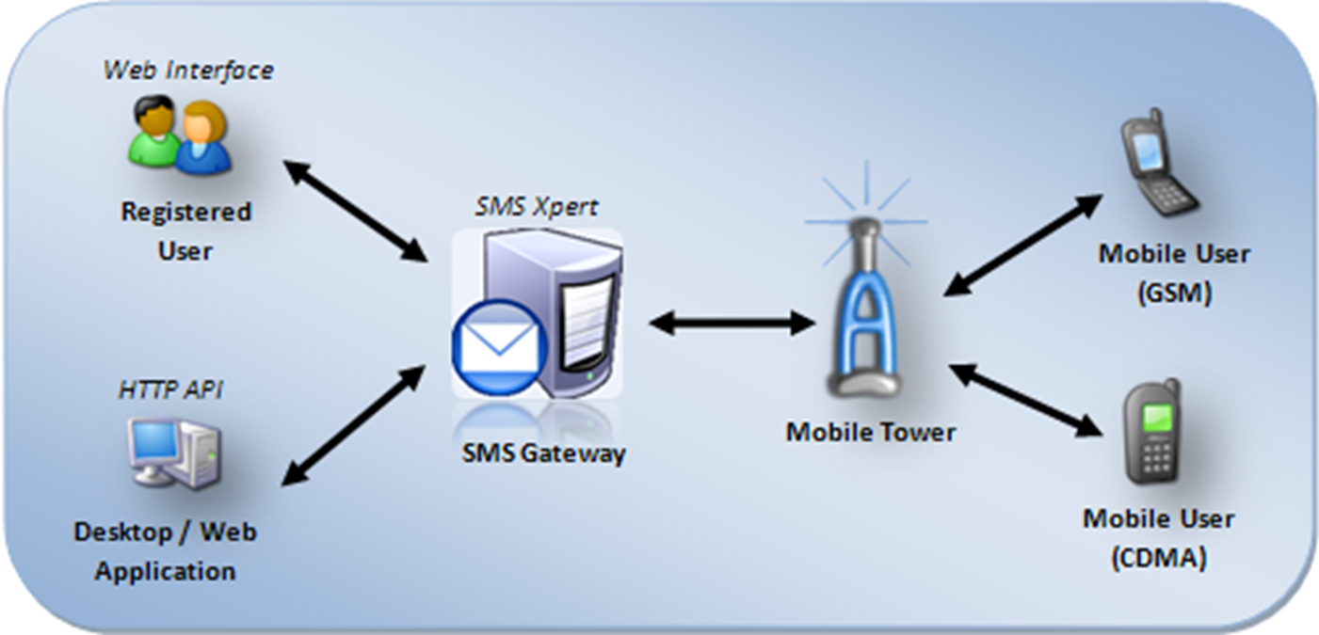

PROPOSED ARCHITECTURE

Slide 10
ADVANTAGES OF THE PROPOSED SYSTEM
Can produce higher Vote outcome percentage in elections.
Easily available to anyone who is interested to vote without standing in long queues, and hence saves lot of time.
Highly responsive message system, to guide the registered voters as how to use the voting system and to provide acknowledgements.
Instantaneously connected to the databases, and uses highly encrypted and secured database systems.
Has well defined fall backs and backup measures. In-case any module of the System fails.

Slide 11
MODULES
The Various Modules of our proposed system are as follows.
  Web Site
  SMS Gateway
  Web Server
  Client Mobile
  Security

Slide 12
WEBSITE
The Website Delivers all functions of the current Pre Voting facilities available manually to voters. It is designed using HTML5 and CSS3 and uses JavaScript. PHP and Reverse AJAX (Comet) are used in the backend. Every function, from registering as a legal voter to checking the updated vote results are available in the web site. The website has 5 Main pages, each with a specific function.
  Administrator Login Page
  Candidate Registration Page
  Voter Registration Page
  SMS Vote Registration Page
  Result Page

Slide 13
SMS GATEWAY
The SMS Gateway is the brain and backbone for the entire system. It is a highly secured, remote and autonomous entity which controls and manages the entire voting process.
An SMS gateway allows a computer to send or receive Short Message Service (SMS) transmissions to or from a telecommunications network. Most messages are eventually routed into the mobile phone networks. Many SMS gateways support media conversion from email and other formats.
In the Proposed System, The SMS gateway is implemented as an Android application on a remote device, which has access to high speed internet and processing speed. It can also be implemented as cloud based web service, with a specific GSM number to which messages can be sent. The SMS gateway basically acts as an intermediary between the end client voter and the web server holding the election data. The Gateway is implemented using JAVA, JSON and uses HTTP responses to interact with the webserver.

Slide 14
WEB SERVER
The webserver is an apache run backend, which stores all the user and candidate data securely in an encrypted format. All Election Day details are stored and processed in the web server. It is essentially a cloud based server application to enact the Election System functions. The web server is designed and developed using Apache server controls, PHP script processing and MySql database structures. The Cloud server is hosted in a secure, remote system with access only to authorized personnel. Other than that, the server is fully autonomous and functions on its own.

Slide 15
CLIENT MOBILE
The required client device is GSM/CDMA enabled mobile phone, with basic SMS reading and writing capabilities. Since the proposed system requires only a basic mobile than a smartphone, almost every eligible citizen will atone well from this system.
The Format for sending the vote SMS will be informed to the voter a few days prior to the Election Day. Also, the user will receive candidate details in the region where the voter is eligible. Also, the users can subscribe for the election results too in the mobile phone.

Slide 16
SECURITY
All election related content, Voter ID, Candidate ID, Phone Number and details in the web server are encrypted using two-level AES Encryption Algorithm. The Unique ID and Vote SMS are encrypted using Camellia-256-CBC Encryption Algorithm, and uses remote keys and Hashing mechanisms to validate the unique ID during voting. The System is highly backed up and heavily secured with both the encryption standards and hence is unlikely to break in a hacking attempt.

Slide 17
3 PHASES
Phase I: Registration
Phase II: Voting Process
Phase III: Acquiring Results

Slide 18
REGISTRATION
If no Voter ID has been registered before, the registering voter is required to go to the proposed system’s website and go to the page for registering new voters. The user should then provide the details as requested by the web page and submit the form. After PHP validation, each voter’s details and records are verified by an authorized person and he/she updates the details like name, address, phone number and region of voter in Election Server Database (ESB).
After receiving the Voter ID card with Voter ID number, the voter, if he wants to cast his vote through SMS, has to register separately for the same in the same website. The voter has to provide a phone number during this process. The form is validated after submitting and a Unique ID is generated to the user as a message to the phone number provided during registering for SMS voting.

Slide 19
VOTING PROCESS
On the day of voting, all the candidate details with respect to the region of the voter are sent as SMS from the Election Server (ES). The message consists of names of various candidates, party name and candidate code. The voter has to send the SMS in order to cast the vote. Voting message format is “VOTE_voter id_unique id_candidate id”. Once the vote is caste unique id will get expired in order to prevent false voting.

Slide 20
ACQUIRING RESULTS
On the day of result, the user has to send SMS in particular format in order to acquire the result. Message format is “RESULT_voter id_unique id”. The server will then respond to this message with the candidate name, party name and the number of votes for all candidates of the region which the user has specified in the message.

Slide 21
SCREENSHOTS

Slide 22
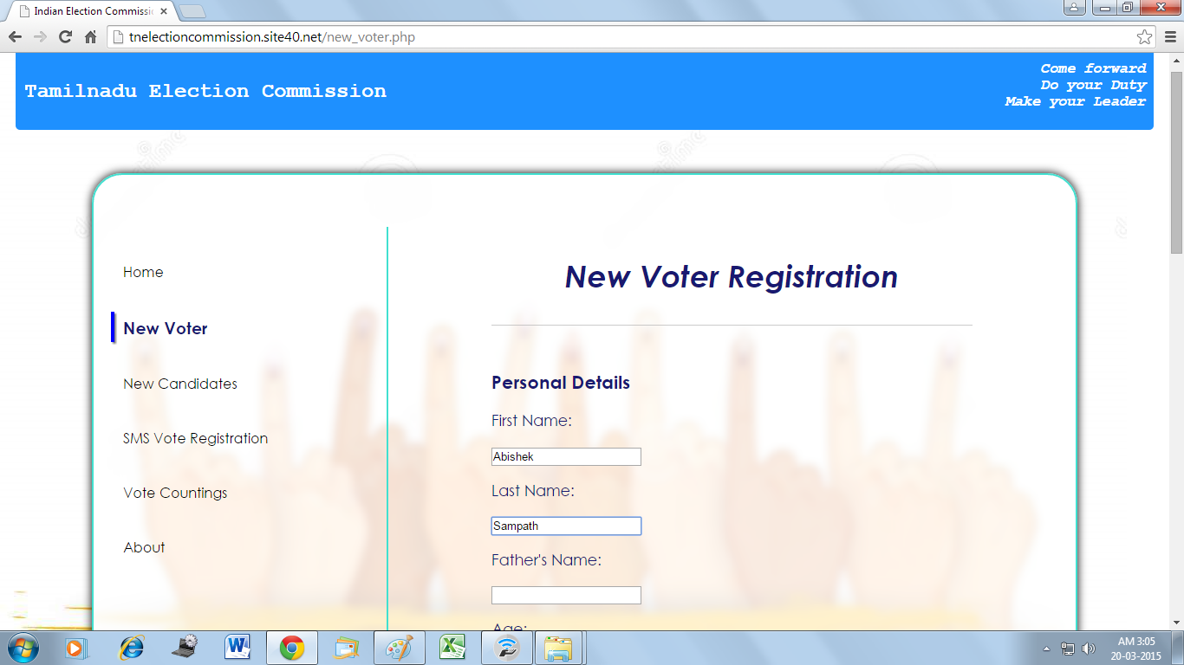

Slide 23
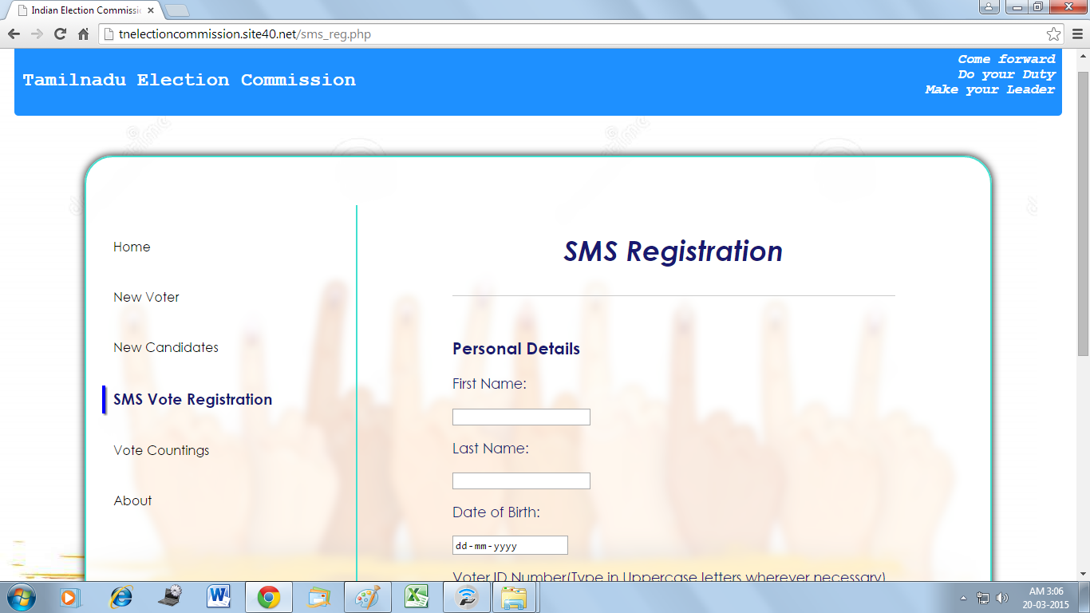

Slide 24
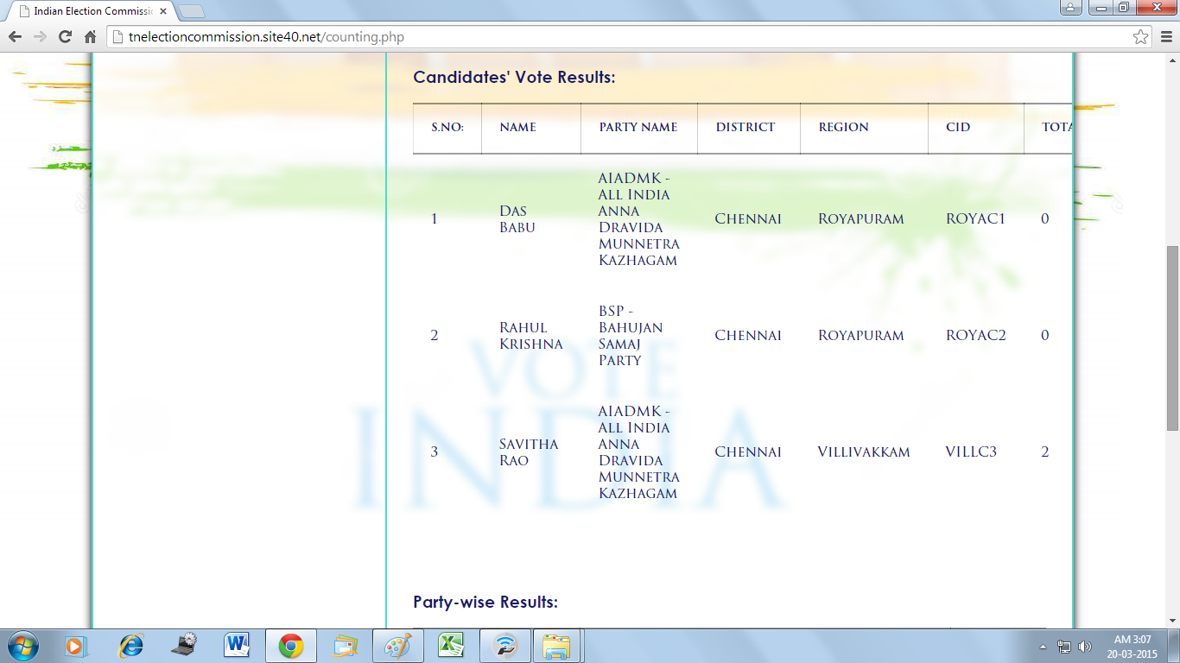

Slide 25
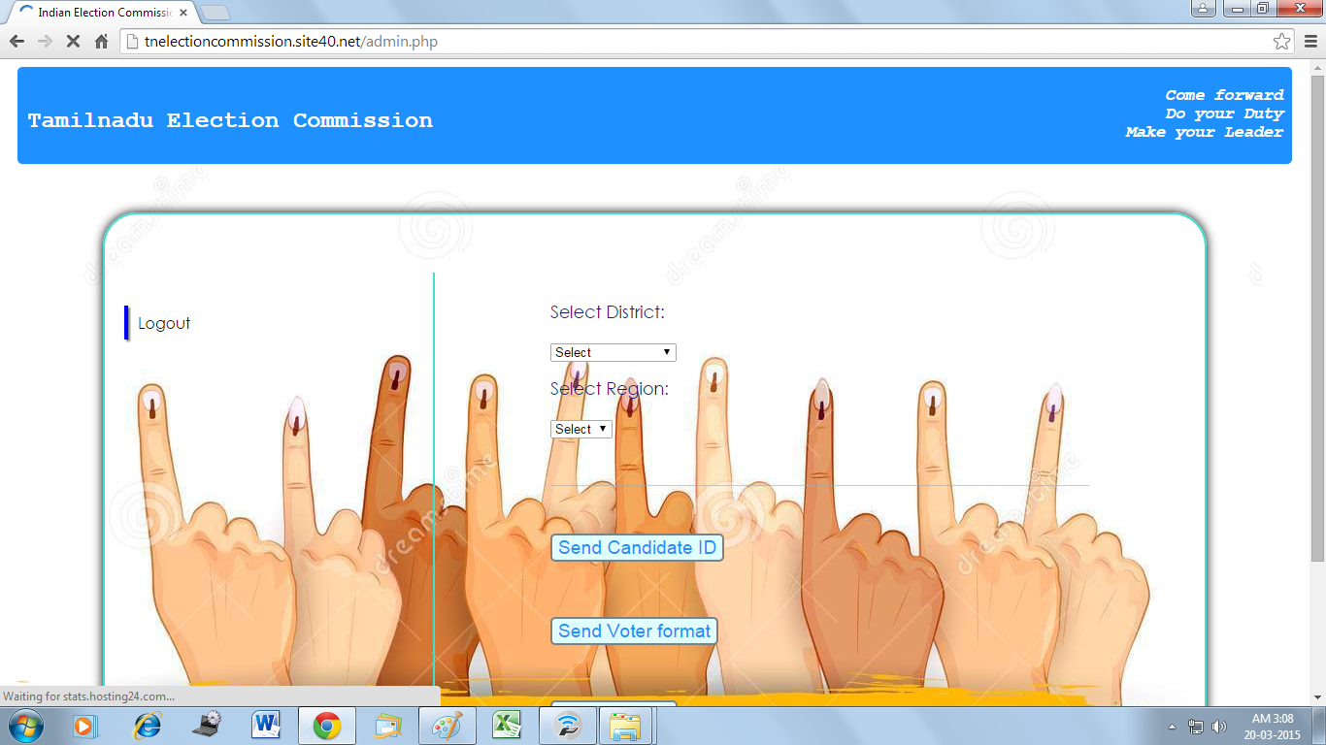

Slide 26
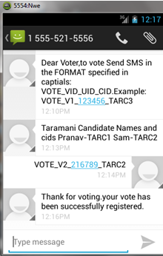
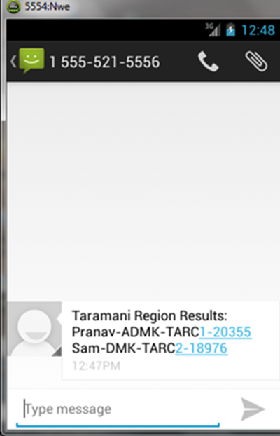

Slide 27
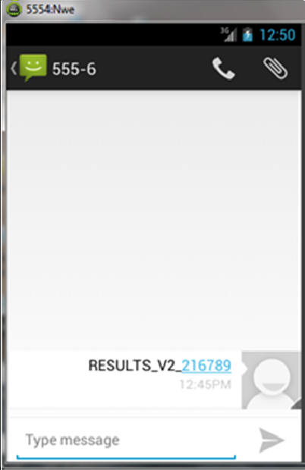

Slide 28
CONCLUSION
This project proposes mobile phone SMS Voting (MPSV) with online/offline mobile voting registration. System prevents double voting in case of casting ballots first from mobile phone and then from pooling booth. Proposed system is more efficient and reliable in the sense that data will be sent to the election commission server through secure SMS. Our system doesn’t need internet or any special hardware device which reduces the cost. System only requires mobile phone and SIM card. This system saves money and time requirement as in the traditional voting system. Also it is eco-friendly and avoids wastage of paper.
Also, our system is proposed only as an extension to the current system. Having a separate registration process for the SMS voters allows the proposed system to be integrated with the existing Electronic Voting or Paper Ballot Systems, thus enabling busy citizens and IT people to vote in an easy way, and also providing voting options to the eligible citizens, both at rural and urban areas. In future, as people embrace technology completely, this system could replace the existing systems and provide easy voting mechanisms in elections.

Slide 29
FUTURE ENHANCEMENT
As the future work and our contribution we enhance the system by creating a instance randomly notifying a message system that should instead be blocked, or detecting modifications to profile attributes that have been made for the only purpose of defeating the filtering system. Automatically user will get a mail notification.
Registering multiple eligible citizens using the same mobile phone number (for example, members of a single family) and ensuring anonymity and security of the same.

Slide 30
REFERENCES
Adel Khelifi, Yasmin Grisi, Dima Soufi, Dalya Mohanad, “A Reliable and Highly Secure Mobile Voting System” in Palestinian International Conference on Information and Communication Technology, 2013
Mohib Ullah, Arif Iqbal Umar, Noor ul Amin, Nizamuddin, “An Efficient and Secure Mobile Phone Voting System” in IEEE International Conference on Computational Intelligence and Security, 2013.
Prof.S.M. Jambhulkar Dept. Of Electronics Engg. R.G.C.E.R., “A Secure Approach for Web Based Internet Voting System using Multiple Encryption” in International Conference on Electronic Systems, Signal Processing and Computing Technologies, 2014
SMS Message and SMS Manager. Android API’s. Retrieved from Android website: http://developer.android.com/reference/android/telephony/SmsMessage.html

Slide 31
Building a Cloud based SMS banking solution – Case Study. Retrieved from Infinite Website: http://www.infinite.com/resources/case-study/cloudbased-case-study
Pavlo. B. and Ekimov. V., “WeVote - Mobile Voting System”, Retrieved from http://code.google.com/p/wevote/, November 4 2010.
Election Systems, Election Types, E-voting, Countries with Internet Voting. Retrieved from Wiki Website : http://www.wikipedia .com
Gateway, SMS gateway mechanisms, Implementations. Retrieved from Stackoverflow: http://stackoverflow.com/questions/26467954/how-to-integrate-sms-gateway-with-the-server-of-parse-com.
Election registration details. Retrieved from Indian Election Commission website: http://eci.nic.in/
Encryption and security. Retrieved from http://www.phpaes.com

Slide 32
THANK YOU
DO YOU HAVE ANY QUERIES?

